Slide 1

REAL ESTATE PRICE PREDICTION USING DEVELOPMENT OF “THINKING” COMPUTERS
PS-II | REVIEW-II | GB3
GUIDED BY:
PROF. DHANASHREE PATIL
PCCoE COMPUTER DEPARTMENT
GROUP MEMBERS:
HARSH LAD [BECOB225]
SANGRAM MORE [BECOB237]
KUNAL MOTE [BECOB238]
OWAIS MIRZA [BECOB253]

Slide 2

INDEX
SR. NO. | TITLE | SLIDE NO.
1. | INTRODUCTION | 3
2. | MOTIVATION | 4
3. | OBJECTIVES | 5
4. | PROJECT STAGES | 6
5. | USER PROCESS | 7
6. | SELECTION PARAMETERS | 8
7. | SYSTEM DESIGN | 9
8. | TOOLS & TECHNOLOGIES | 10
9. | NOVELTY of PROPOSED WORK | 11
10. | MACHINE LEARNING MODELS: LINE GRAPHS [REG.] | 12
11. | MACHINE LEARNING MODELS: LINE GRAPHS [CROSS-VAL.] | 14
12. | MACHINE LEARNING MODELS: ACCURACY | 16
13. | CONCLUSION | 17

Slide 3

Introduction
PROBLEM DEFINITION
Real estate value in India has not been given enough attention. Sellers take advantage of this and raise prices as a result. Because there is no standardised list to help potential purchasers make a wise purchase selection, the process to buy these residential properties in India is skewed. An ordinary guy cannot fully consider the many market trends and their effects on the cost of real estate.

Slide 4

MOTIVATION
To find affordable real estate prices for residential prospects.
To provide rate stability and distribution in the market.
To attain reliable and faster results of residential price analysis.
To imbibe accuracy of price per square footage of residential prospects.

Slide 5
OBJECTIVES
To build a highly predictive real estate price prediction model.
To help the user find affordable rates of residential prospects.
To increase the accuracy of model prediction for residential costs.
To enhance the parameters that are used as the main decider component in the model.

Slide 6




PROJECT STAGES
Stage-I: 1-2 | Stage-II: 3-4
STEP 1
STEP 2
STEP 3
STEP 4
STEP 5
REQUIRMENT
& DEFINITION
DESIGN & CODE
O-O Designs
Programming Models
ENHANCEMENT
Cross-Validation
Hyper-Parameter Tuning
INTEGRATION
GUI x Backend
TESTING

Slide 7



USER PROCESS
LOCALITY
PARAMETER SEARCH
IDEAL PROPERTY

Slide 8
1.
2.
1
2
Primary:
Area
City
Location
No. of Bedrooms
Resale
Secondary:
Maintenance
Utilities
Educational Inst.
F&B Outlets
SELECTION
PARAMETERS

Slide 9
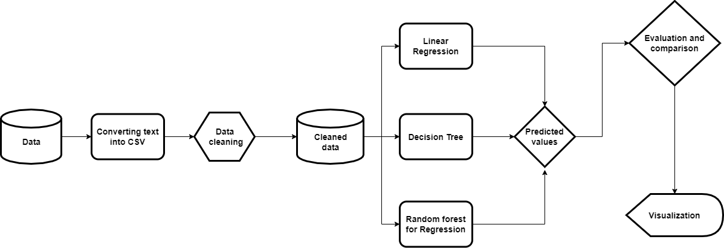
SYSTEM DIAGRAM

Slide 10
TOOLS & TECHNOLOGIES
PROGRAMMING LANGUAGE
PLATFORM & VISUALIZATION TOOL
DATA SOURCE
REPOSITORY
PYTHON
JUPYTER LABS
KAGGLE
GitHub

Slide 11

Novelty of Proposed Work
8 Model Comparison
Intricate and vast comparison amongst 8 different machine learning models.
India Based Dataset
Dataset with datapoints based on Indian cities & localities.
Comprehensive Dataset
A comprehensive dataset with over 40+ column parameters.
Cross-Validation & Hyper-Parameter Tuning
Cross-Validation & Hyper-Parameter Tuning are used to enhance accuracy and functioning of the machine learning models.

Slide 12
MACHINE LEARNING MODELS
LINE GRAPHS [REGULAR]

Slide 13
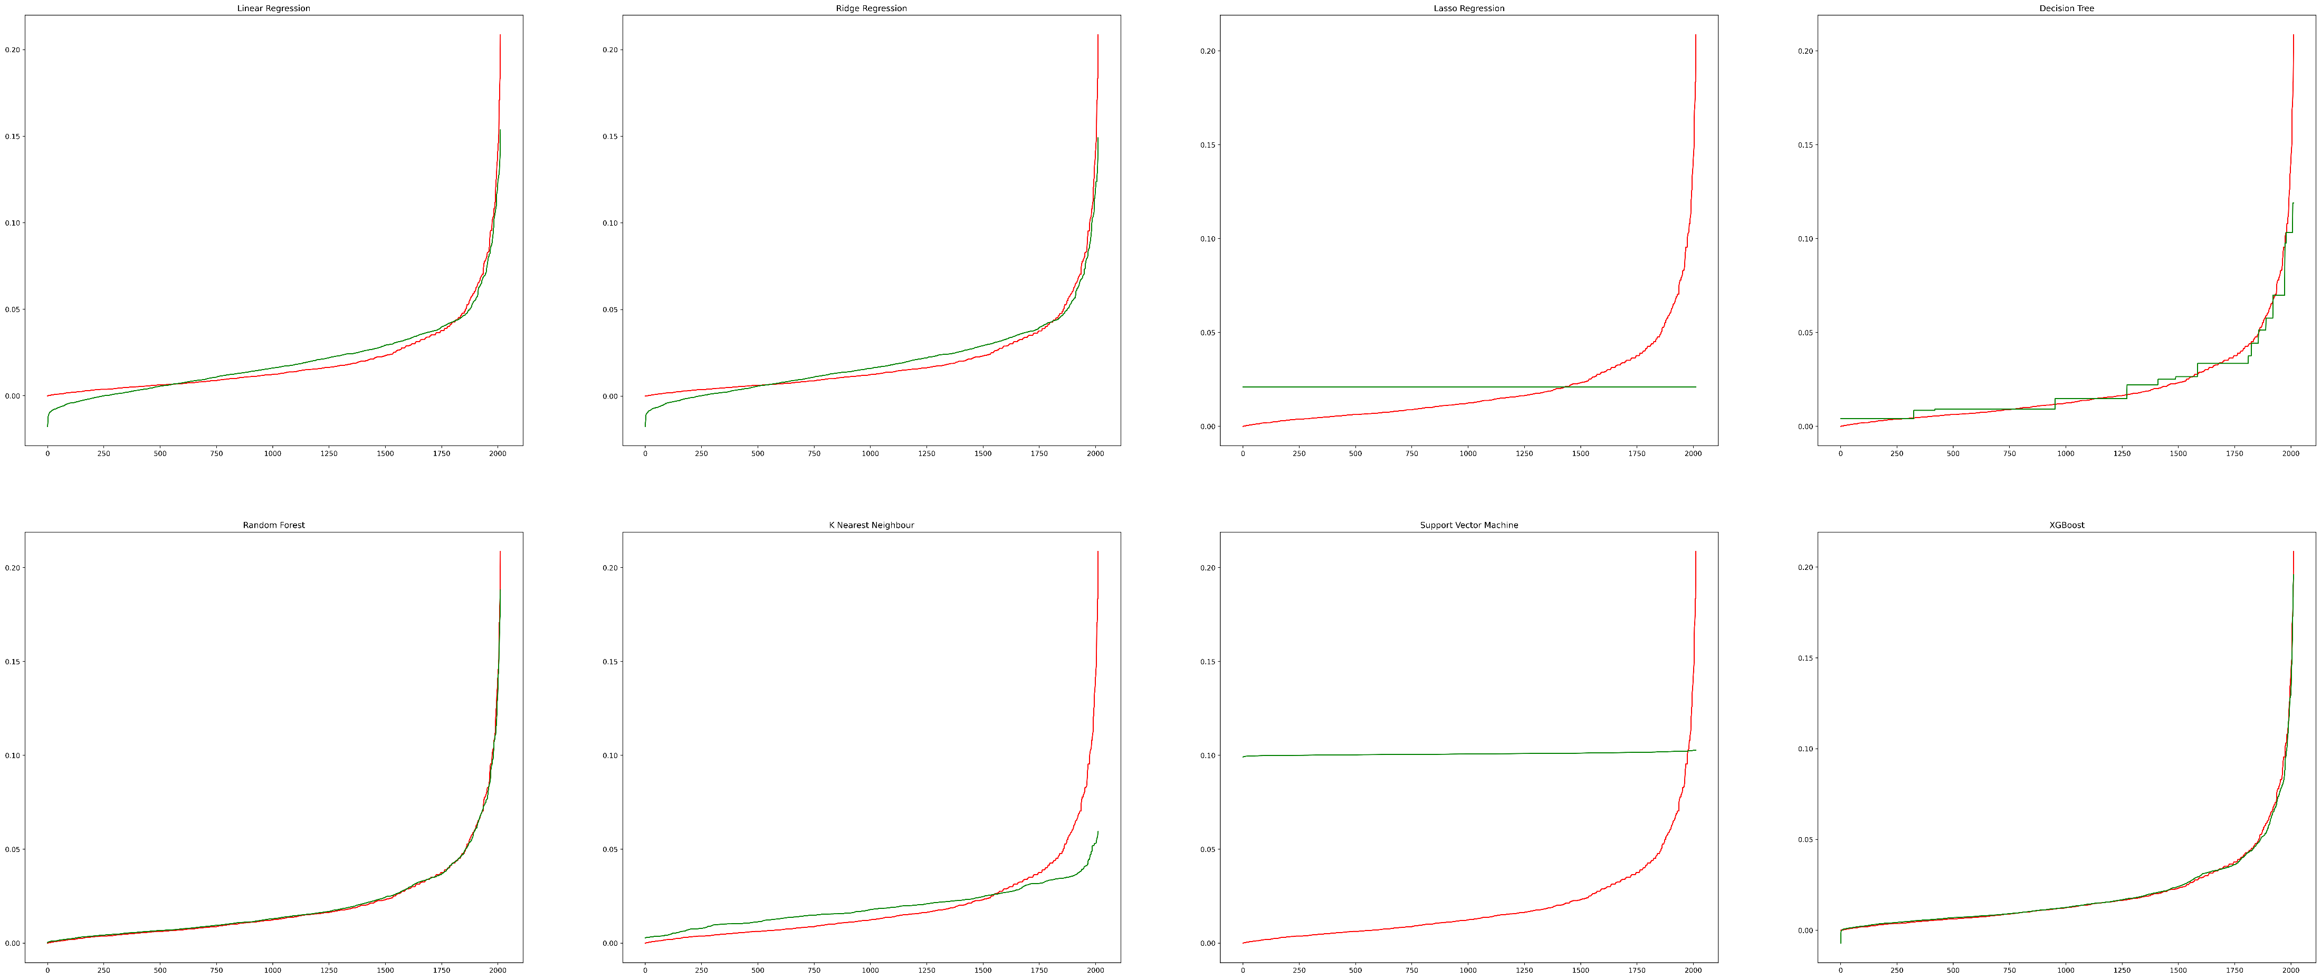

Slide 14
MACHINE LEARNING MODELS
LINE GRAPHS [CROSS-VAL.]

Slide 15
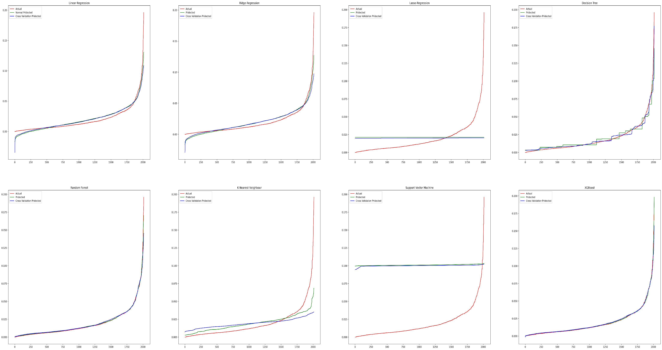

Slide 16
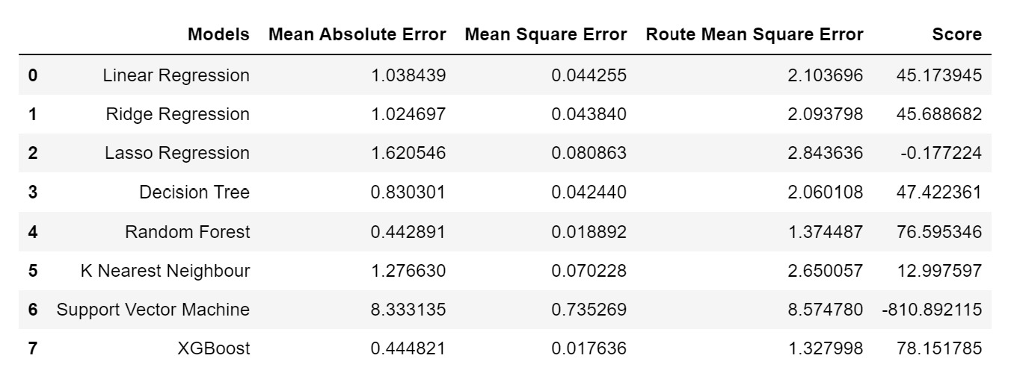
MACHINE LEARNING MODELS
ACCURACY

Slide 17

CONCLUSION
On in-depth testing and validation of our above 8 machine learning models, we have concluded that XGBoost and Random-Forest produce peak results of 78.1517% and 76.5953% respectively when compared to the remaining models. Linear Regression, Ridge Regression, and Decision Tree come in close ranging between 45-48% accuracy. SVM, K-Nearest Neighbour, and Lasso Regression account for the bottom of the barrel in terms of their accuracy which exists in the low ranges and are not fit for evaluation.

Slide 18
PS-II | REVIEW-II | GB3
Thankyou
GUIDED BY:
PROF. DHANASHREE PATIL
PCCoE COMPUTER DEPARTMENT
GROUP MEMBERS:
HARSH LAD [BECOB225]
SANGRAM MORE [BECOB237]
KUNAL MOTE [BECOB238]
OWAIS MIRZA [BECOB253]

